Slide 1

Cat Protector
Directed by : Mounira Zouabi

Slide 2
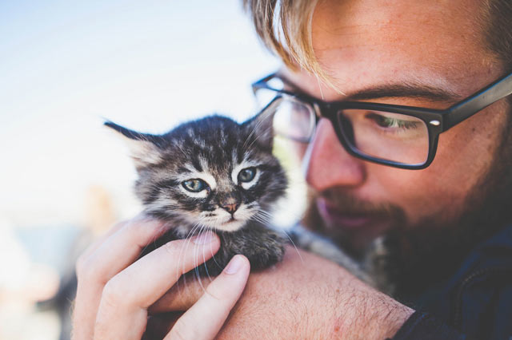
Descreption
Cat protector is an application
to protect cats in Beja by finding the lost one and get a home to homeless

Slide 3
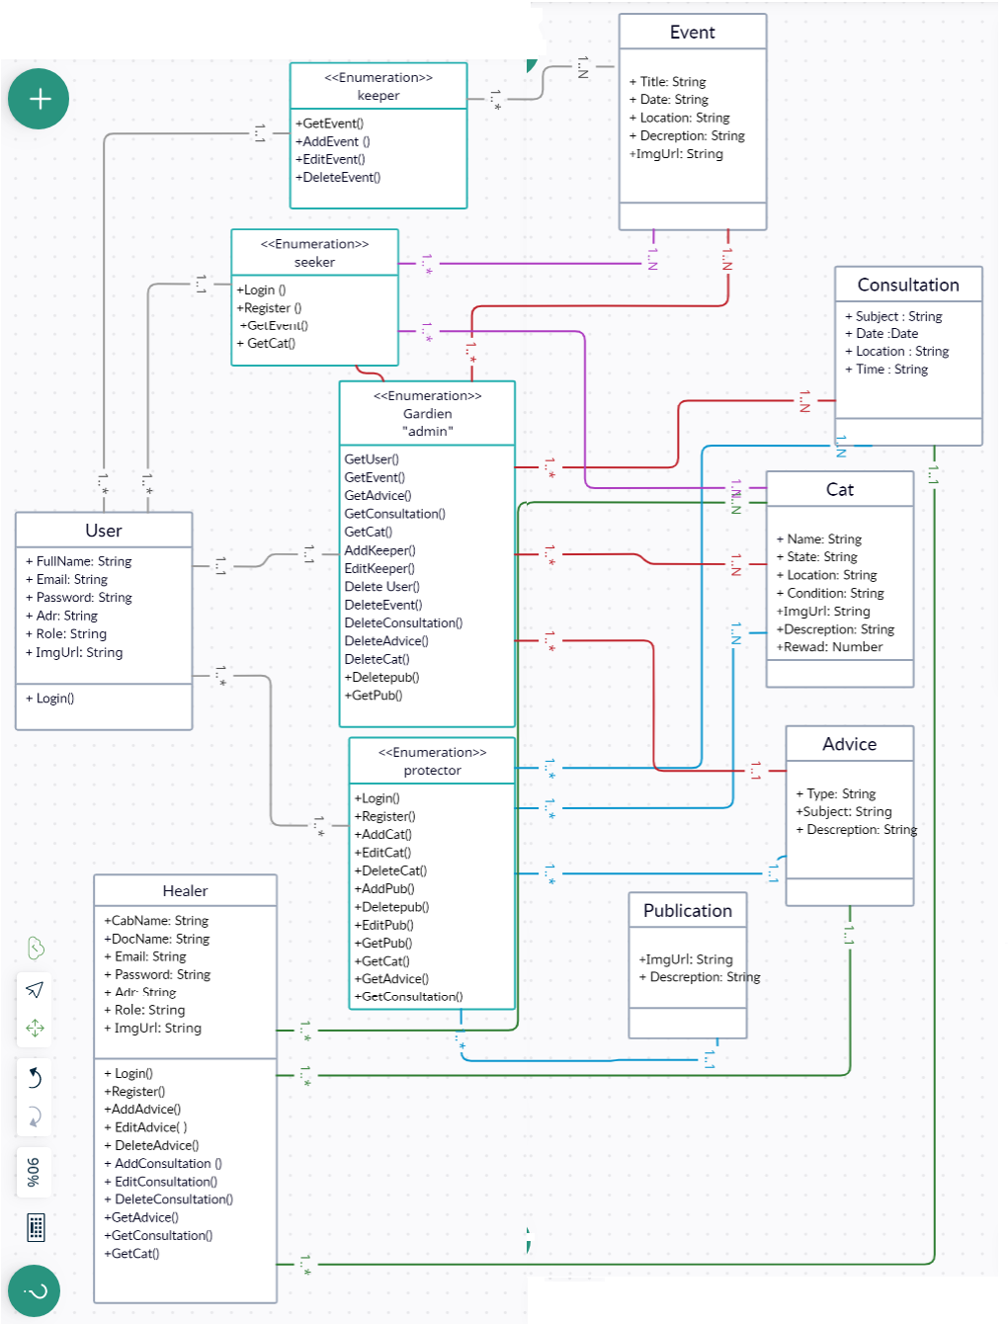
Diagramme de Classe

